Slide 1
welcome

Slide 2




Slide 3
Town of Kiawah island site plan peer review
The West End at Beachwalker Multifamily Residential Development
Ocean Pines Multifamily Residential Development

Slide 4
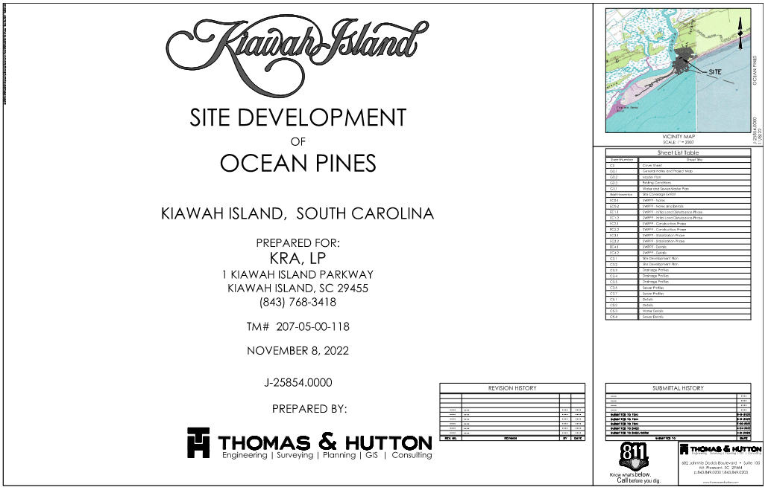
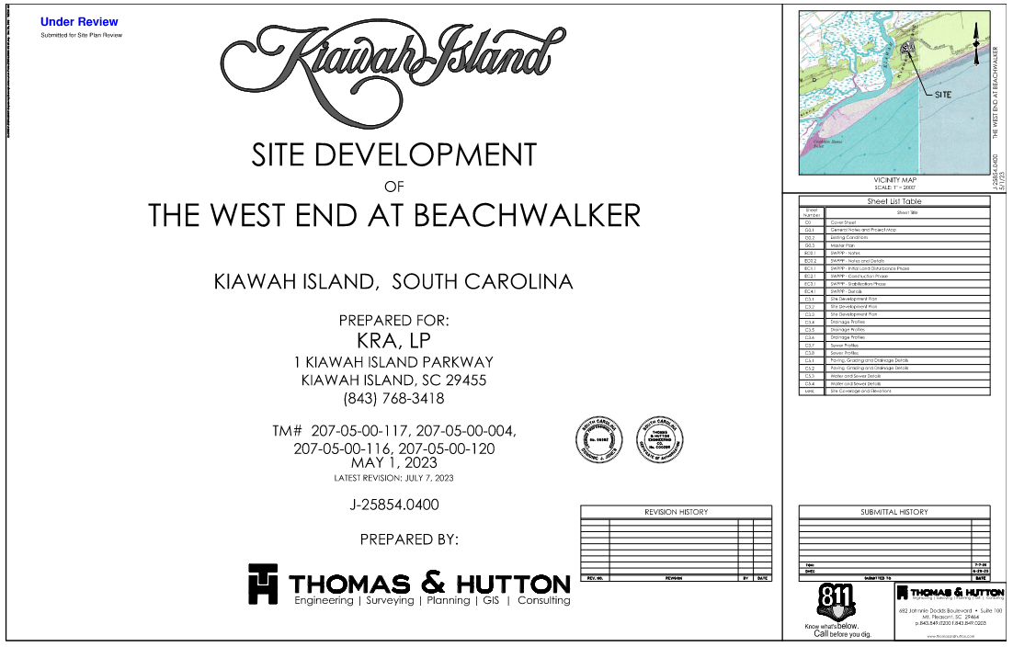
Presentation Agenda
Introduction to Project Team
Peer Review Process
Project Area Overview
The West End at Beachwalker
  Site Plans
  Site Visit
  Planning/Zoning
  Stormwater
Ocean Pines
  Site Plans
  Site Visit
  Planning/Zoning Review
  Stormwater Review

Slide 5

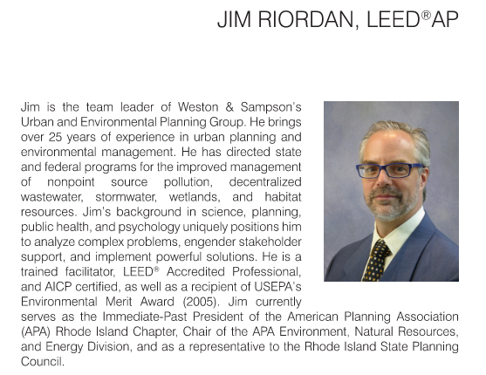

Project Team

Slide 6
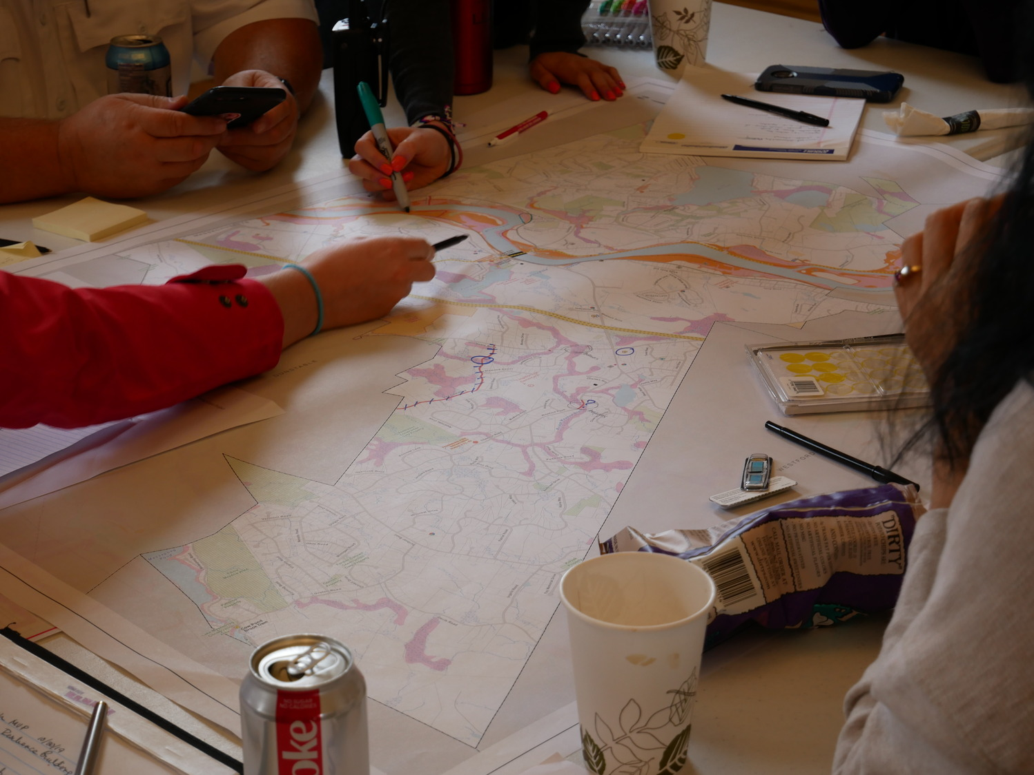
Peer Review Process
General Bylaw Compliance
Site Plan Layout
Constructability
Stormwater
  Charleston County Stormwater Permitting Standards and Procedures Manual

Slide 7
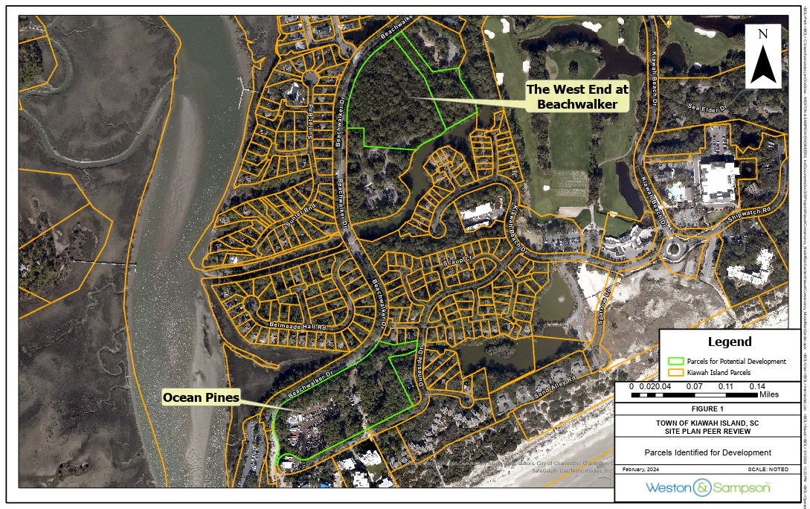
Project Area Overview
The West End at Beachwalker:
  Parcel ID: 2070500116
  Parcel ID: 2070500117
Ocean Pines:
  Parcel ID: 2070500118

Slide 8
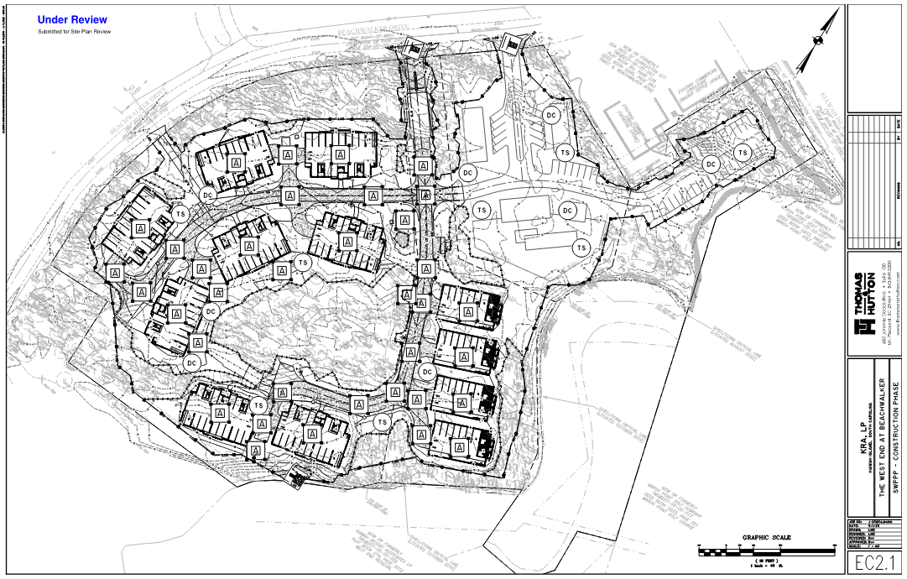
The West End at Beachwalker
Site Plans
~7.6 Acres Between Parcels
  6.4 Acres Proposed for Development
12 Multifamily Residential Buildings
72 Proposed Dwelling Units
Stormwater Routed to Pond 001

Slide 9
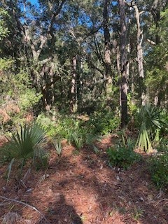
The West End at Beachwalker
Site Visit
Expected Land Alterations
Existing Conditions at the Proposed Entrance to Development
Alterations to Natural Drainage Patterns
Proposed Drainage Tie-ins to Existing Infrastructure

Slide 10
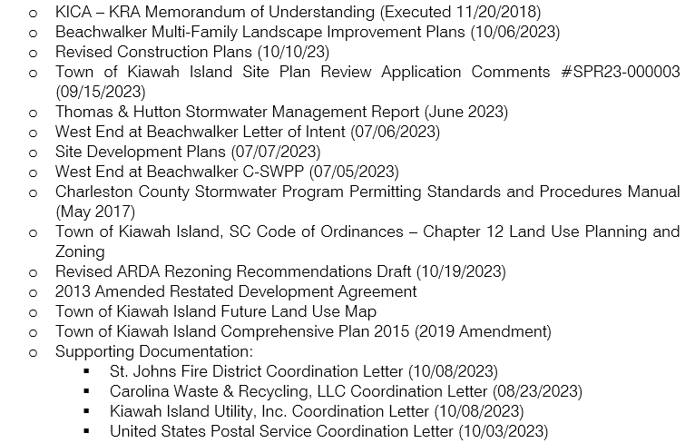
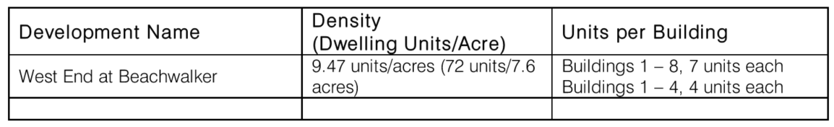
The West End at Beachwalker
Planning/Zoning
R-3/Commercial Zoning District
Maximum Allowable Dwelling Units: <100
  72 Units Proposed
Notes:
Health and Safety – Participation in solid waste management (dumpsters and management were proposed and the proposal has been approved by TOKI)
Use of Sewers – Connection to sanitary sewer proposed and accepted by KIU and TOKI
Parking Prohibitions – Parking at ground level has been proposed – Off-street parking is adequate and in accordance with Sec 128
Flood Damage Prevention – No living space is sited at the elevation of flood waters (AE Zone) – appears to not conflict with local ordinances/enforceable policy

Slide 11
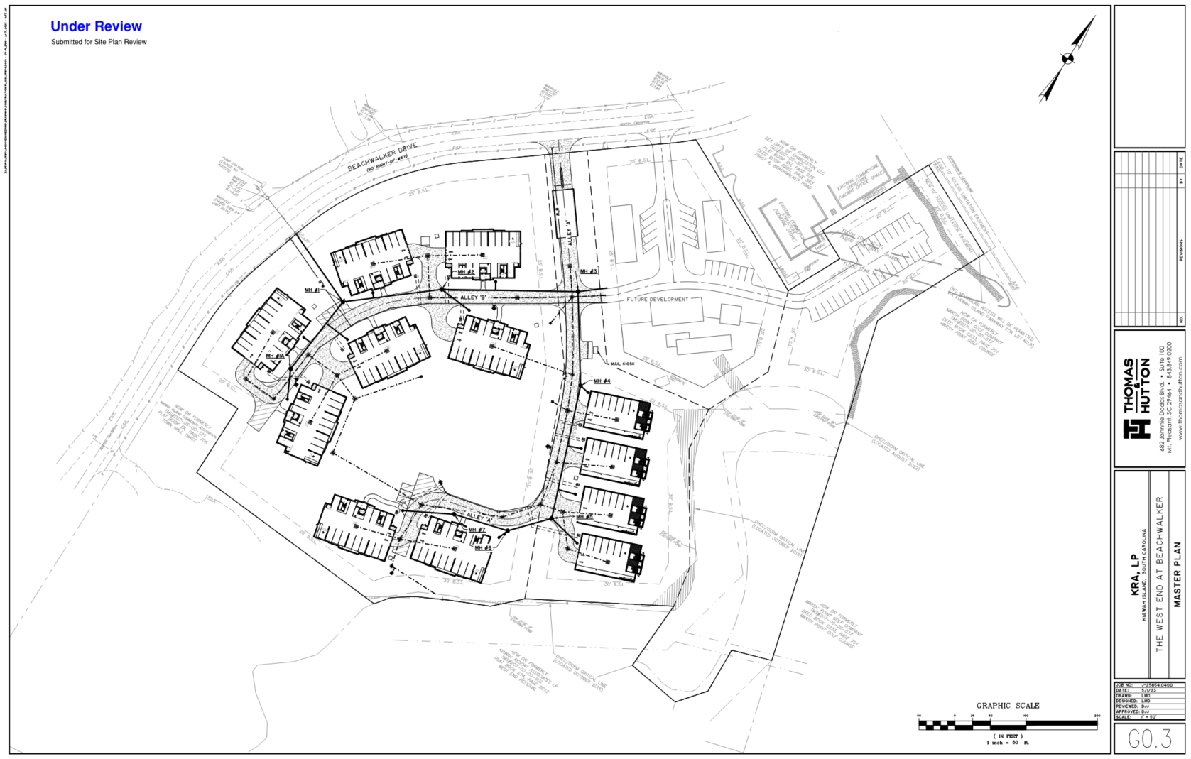
The West End at Beachwalker
Stormwater
Designed Storm Events
  2-year & 10-year Events Provided
    Recommend 25-year
BMP Routine Maintenance Plans
Confirmation of WSE at Pond 1
Outfall Stabilization

Slide 12
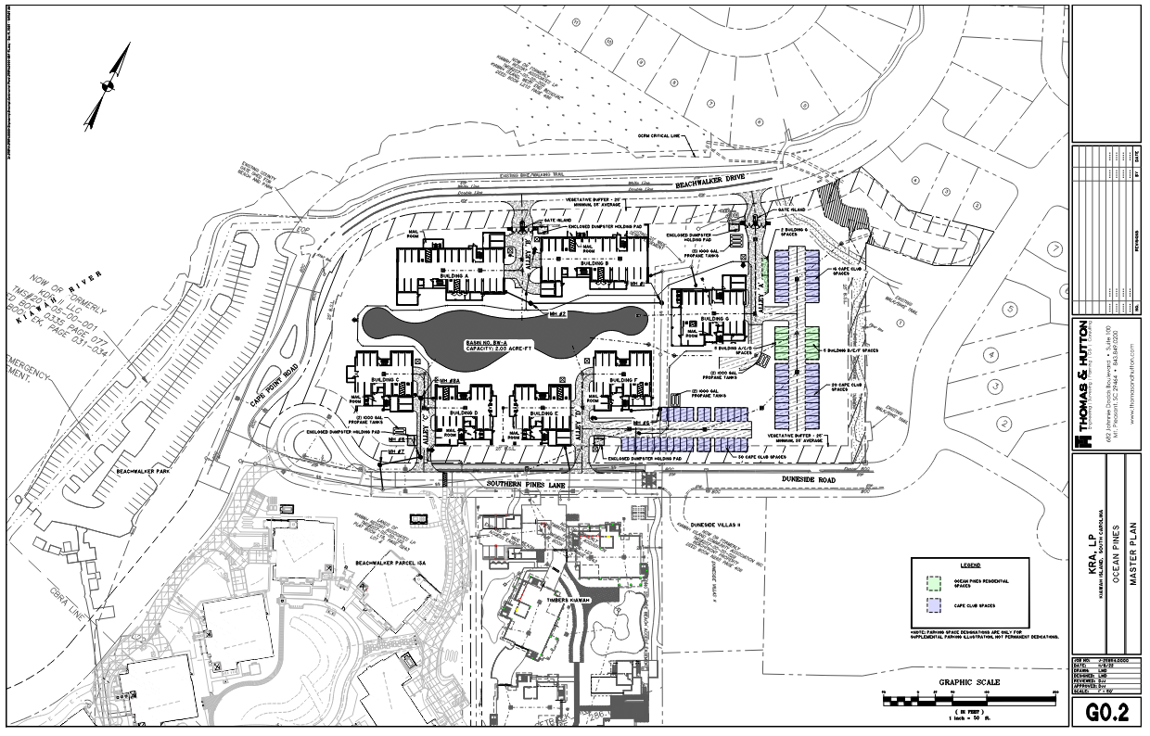
Ocean Pines
Site Plans
7 Acres Proposed for Development
7 Multifamily Residential Buildings
69 Proposed Dwelling Units
Central Stormwater Retention Pond

Slide 13
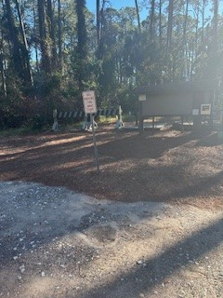
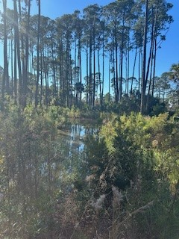
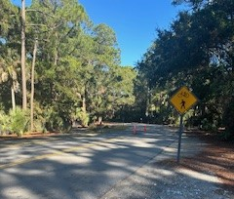
Ocean Pines
Site Visit
Expected Land Alterations
Existing Conditions at the Proposed Entrance to Development
Alterations to Natural Drainage Patterns
Proposed Drainage Tie-ins to Existing Infrastructure

Slide 14
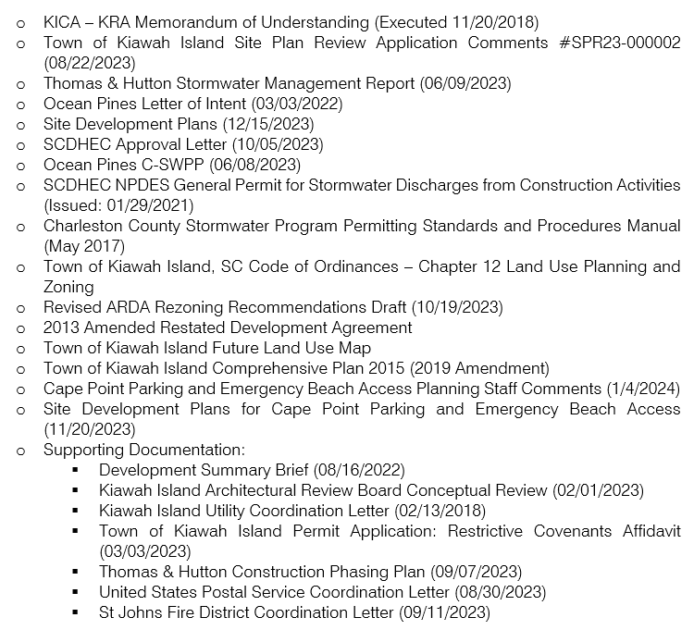
Ocean Pines
Planning/Zoning
R3/Commercial Zoning District
Maximum Allowable Dwelling Units: <100
  69 Units Proposed
Total Number of Parking Spaces Required for On-Site Dwelling Units: 129
  Additional 100 Spaces Required for Cape Point Supplementary Parking
    86 Spaces Were Provided Between the Ocean Pines Site and the Cape Point Emergency Beach Access Project

Slide 15
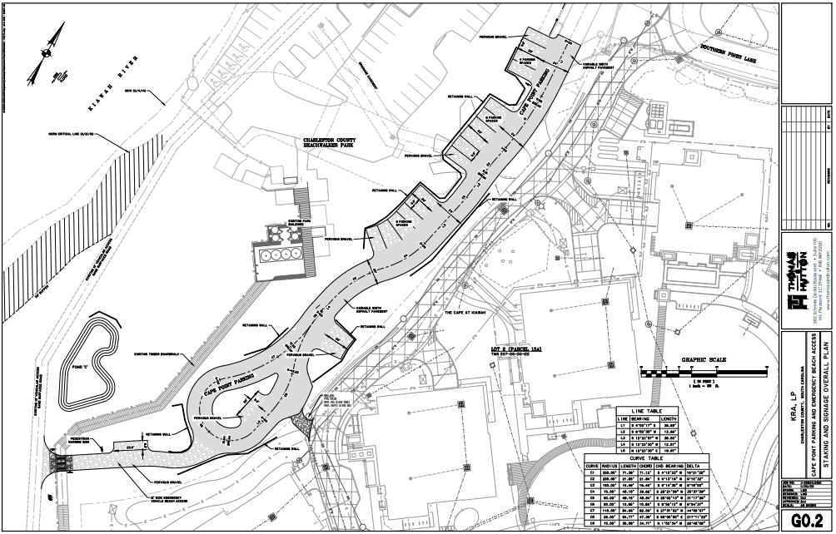
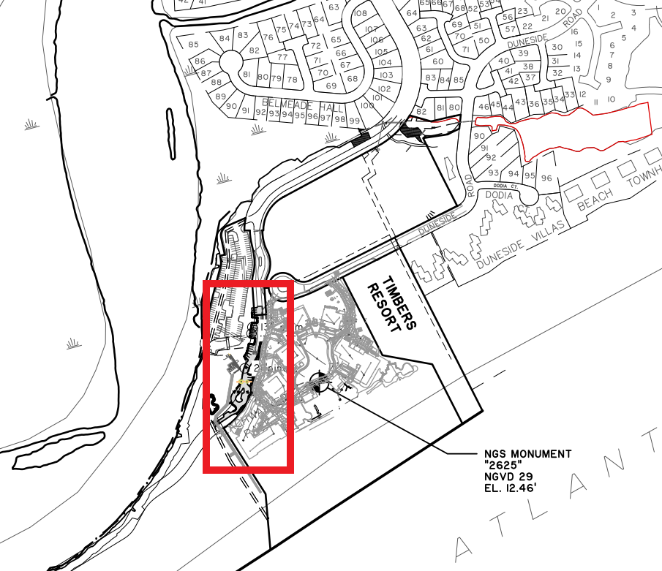
Cape Point Parking Emergency Beach Access
Supplemental Parking
Proposed Driveway
  No Roadway Plat Approval Being Sought After
  Control Gates Will Be Installed
20 Parking Spaces
  Supplement for Cape Point
  Variance Required
ROW Currently Owned and Maintained by Kiawah Resort Associates, L.P.
  KDP II LLC Has Ownership Over Property

Slide 16
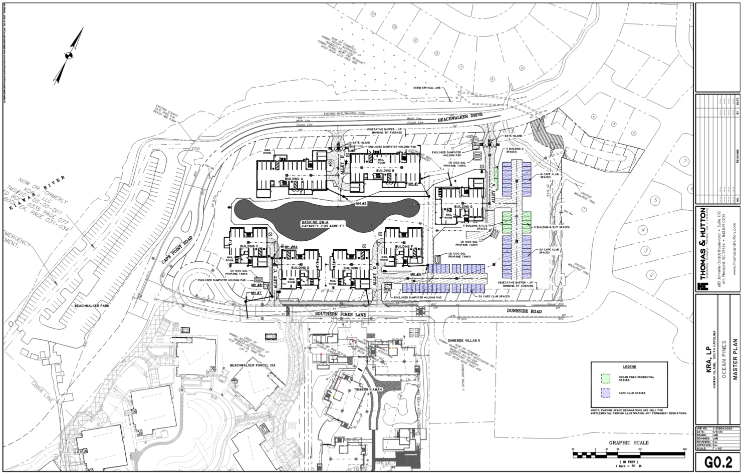
Ocean Pines
Stormwater
Designed Storm Events
  2-year & 10-year Events Provided
    Recommend 25-year
BMP Routine Maintenance Plans
Updated Stormwater Calculations for Revised Plans
Detention Pond
  Deeper Permanent Pool
  Addition of Forebays
  Outlet Control Structure

Slide 18
thank you
westonandsampson.com

